Slide 1
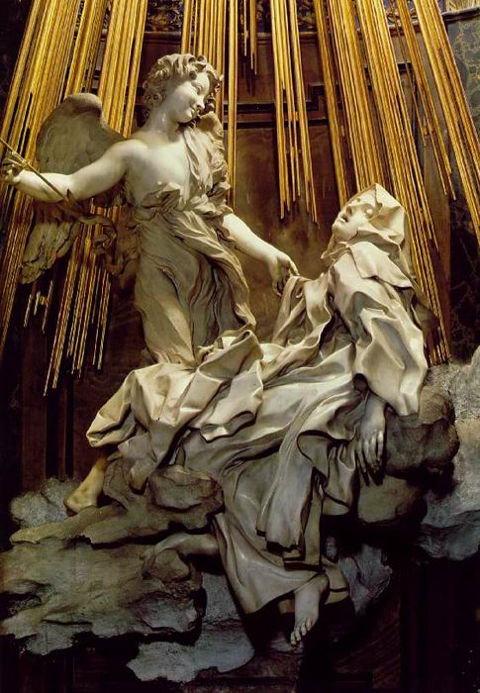
Baroque Striving to Impress

Slide 2
Baroque: Definition
A period of history
A description of artistic/musical style after the Renaissance
Originally a derogatory term-irregular shaped pearl

Slide 3
Causes and Origins
Counter reformation movement (glory of the church)
Rulers wanted a style signifying glory
Artist’s desire to be more expressive
Originated in Italy

Slide 4
Characteristics
How does Baroque compare with the Renaissance?
Unique contributions
Emotion/Religious fervor/Realism
Dramatic (light and shade/perspective)
Exploration of form (elaborateness, exaggeration) but all in control
Virtuosity

Slide 5
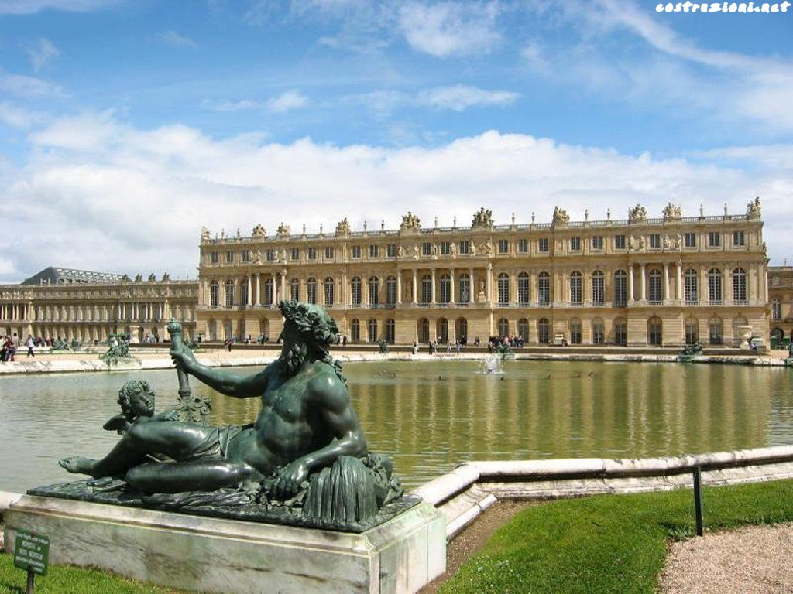
Architecture and Sculpture

Slide 6
Architecture Style
Versailles
Landscaping
Hall of Mirrors
Extravagance

Slide 7
Architecture Style
St. Peter’s Square (Bernini)

Slide 8
Gian Lorenzo Bernini
Baldacchino (Altar covering in St. Peters)

Slide 9
Bernini
Ecstasy of St. Theresa

Slide 10
Bernini
David

Slide 11
Bernini
Apollo and Daphne
Pluto and Persephone

Slide 12
Caravaggio (Michelangelo Merisi)
The Calling of Saint Matthew
Chiaroscuro
Realism

Slide 13
Caravaggio
The Martyrdom of Saint Matthew
Emotion
Perspective

Slide 14
Caravaggio
David with the head of Goliath
Emotion/realism
Perspective (foreshortening)
Light/darkness

Slide 15
Caravaggio: The Supper at Emmaus
Perspective
Realism

Slide 16
Artemesia Gentileschi
Judith and Holofornes
Emotion
Realism
Perspective

Slide 17
El Greco
The Burial of Count Orgaz
Religious fervor
Virtuosity (color)

Slide 18
Diego Velazquez
Las Meninas (Maids of Honor)
Perspective
Virtuosity (detail)
The art of creating art (similar to the view of literature making literature in Don Quixote)

Slide 19
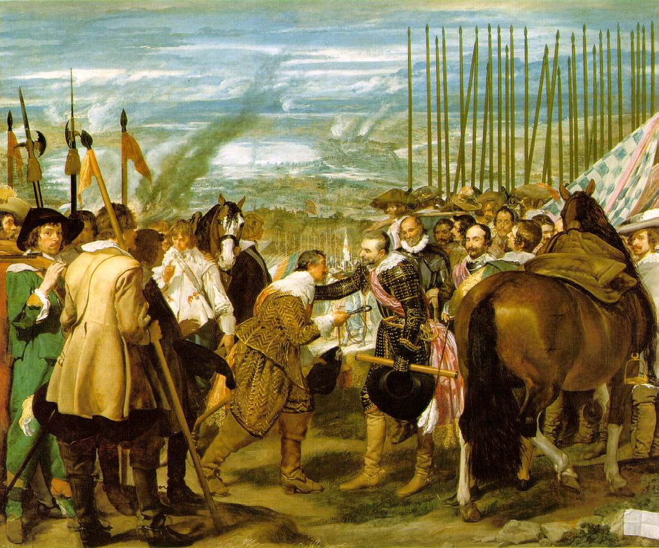
Velazquez: The Surrender of Breda (Las Lances)
Perspective
Virtuosity

Slide 20
Peter Paul Rubens
Henri IV Receiving the Portrait of Marie De Medici
Rape of the Daughters of Leucippus

Slide 21
Anthony Van Dyke
Charles I: King of England at the Hunt
Charles I on Horseback

Slide 22
Rembrandt: Night Watch

Slide 23
Rembrandt
Dr. Tulp’s Anatomy Lesson

Slide 24
Frans Hals
The Laughing Cavalier

Slide 25
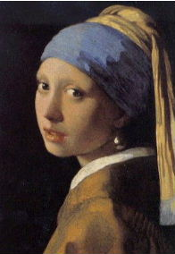
Jan Vermeer
The Art of Painting
Study of a Young Woman

Slide 26
Georges de La Tour
Christ in the Carpenter’s Shop

