Slide 1
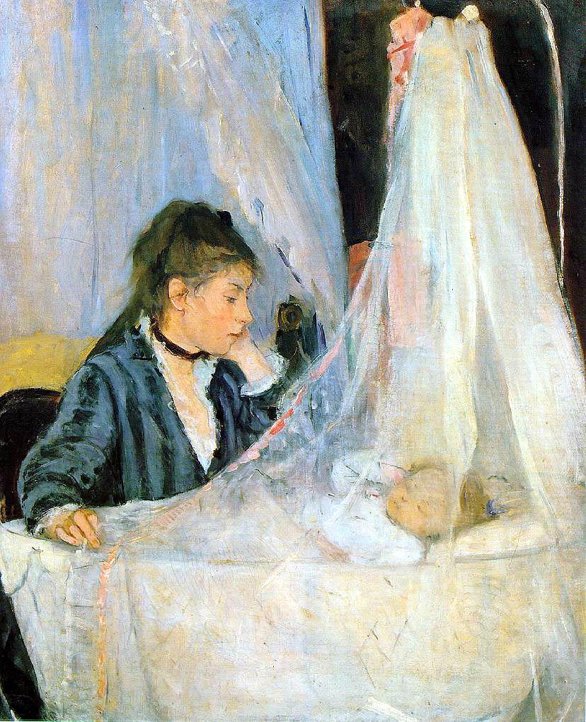
Title of work: The Cradle
Artist: Berthe Morrisot
Year: 1872
Portrait
Oil on canvas
Museum Musée d’Orsay

Slide 2
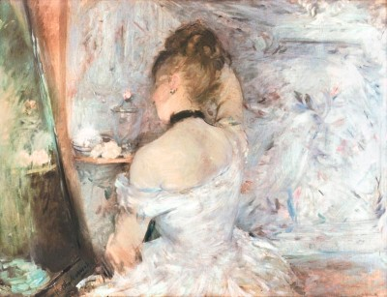
Title: Woman in her toilette
Artist: Berthe Morrisot
Year: 1875 Portrait
Oil on Canvas
Art Institute of Chicago

Slide 3
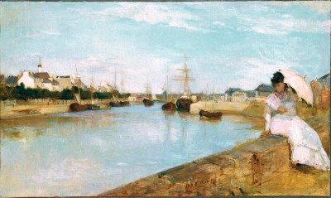
The Harbor at Lorient
Berthe Morisot
Year: 1869
Landscape Oil on canvas
National Gallery of Art, Washington, DC

