Slide 1
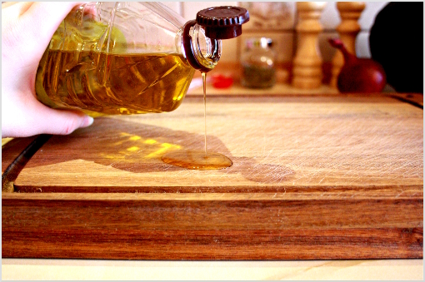

Slide 3
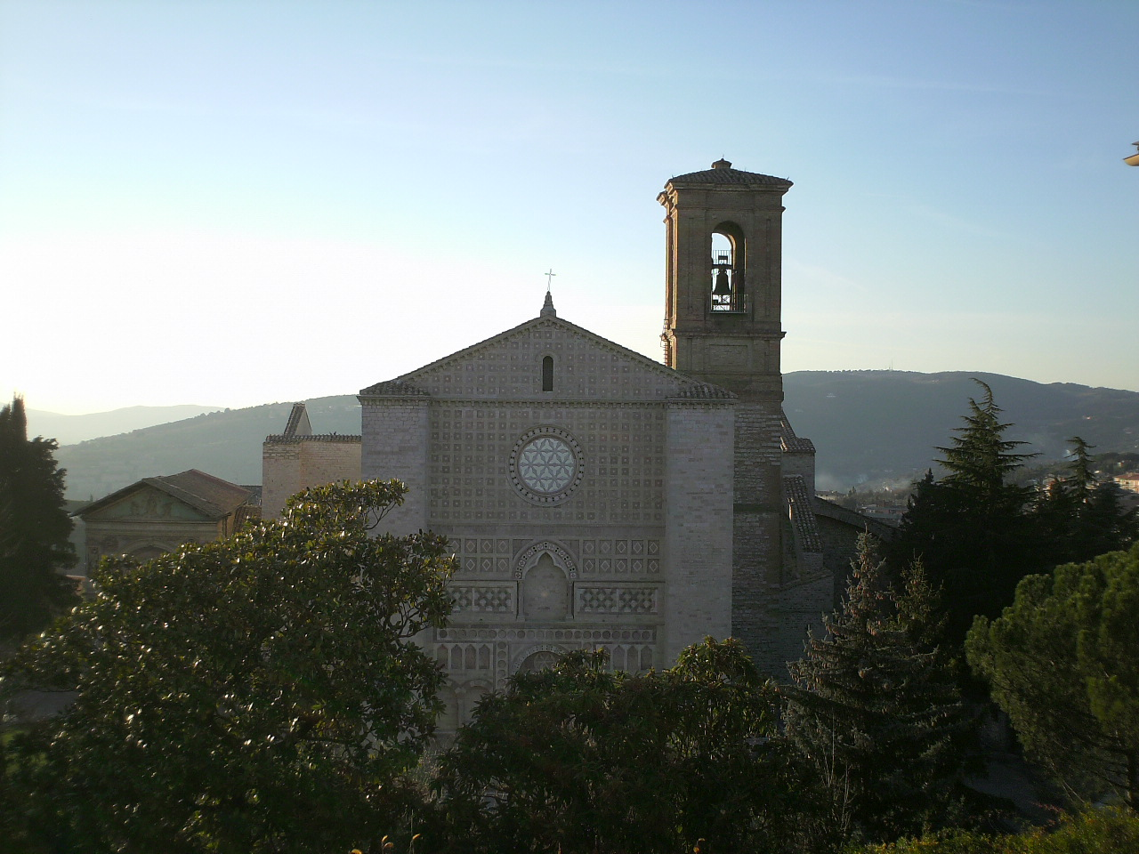

Slide 4
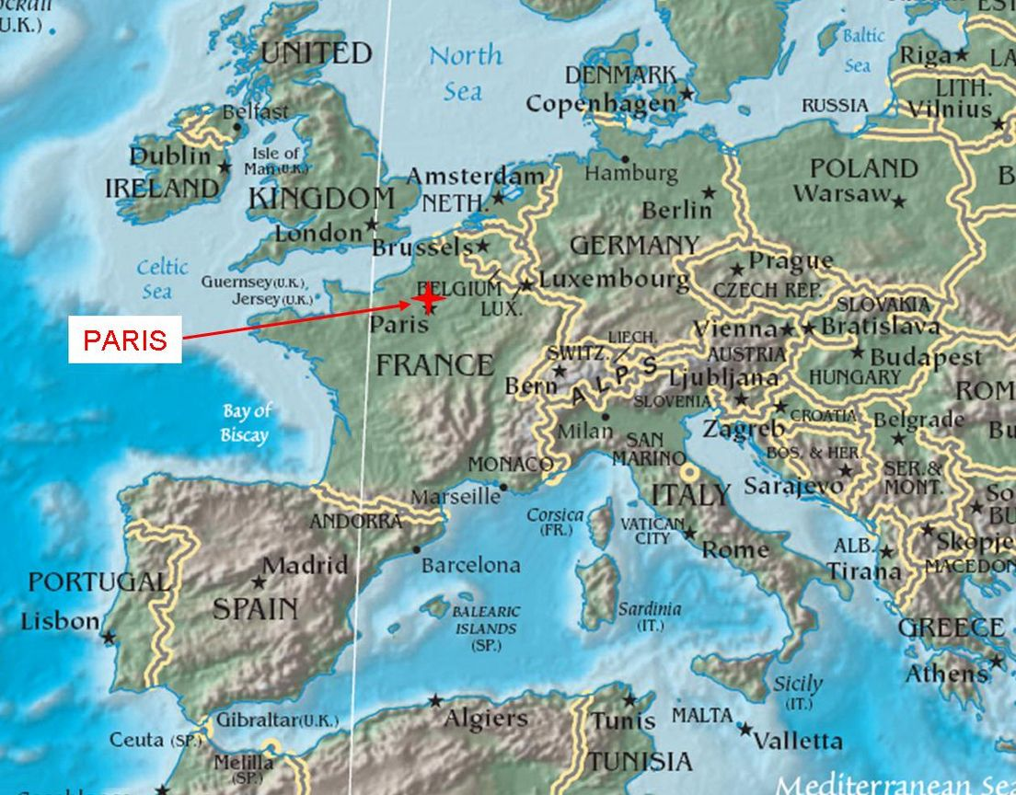

Slide 5
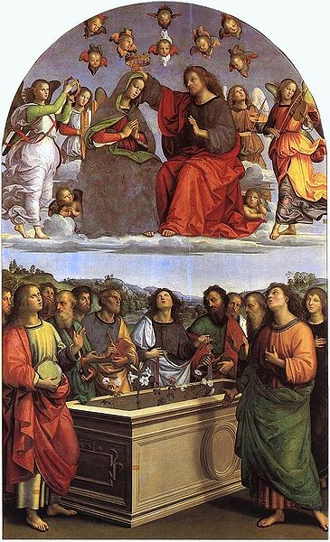
The coronation
The girdle to Saint Thomas
The coronation is the popular Christian art subject in 15th century.

