Slide 1
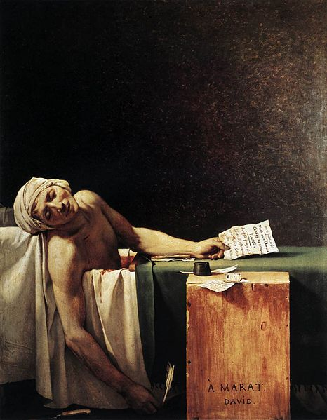
The Death of Marat
Jacques-Louis David

Slide 2
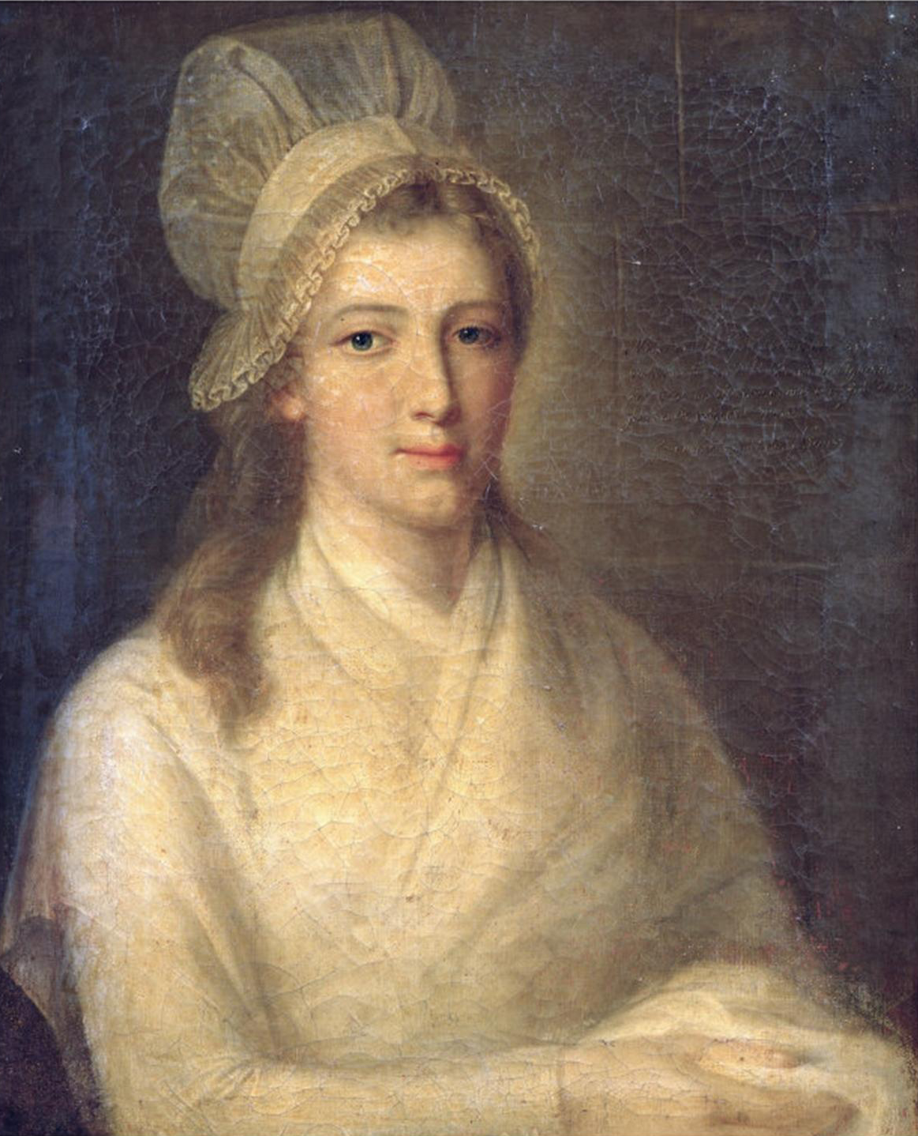
The story behind the painting

Slide 3
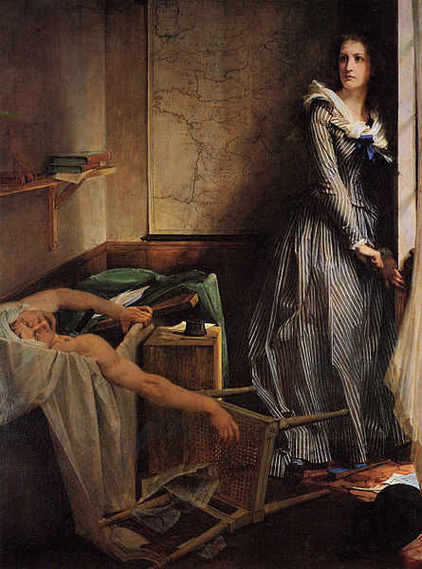

Slide 4
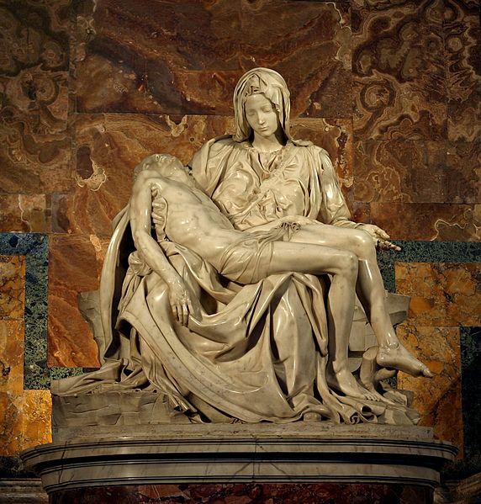

Slide 6
The mornarchy
The Catholic Church
The new Frech Repiblic

