Slide 1
VERMEER
Trang Cao: Technique and Style
Raphael Whitten: Work

Slide 2
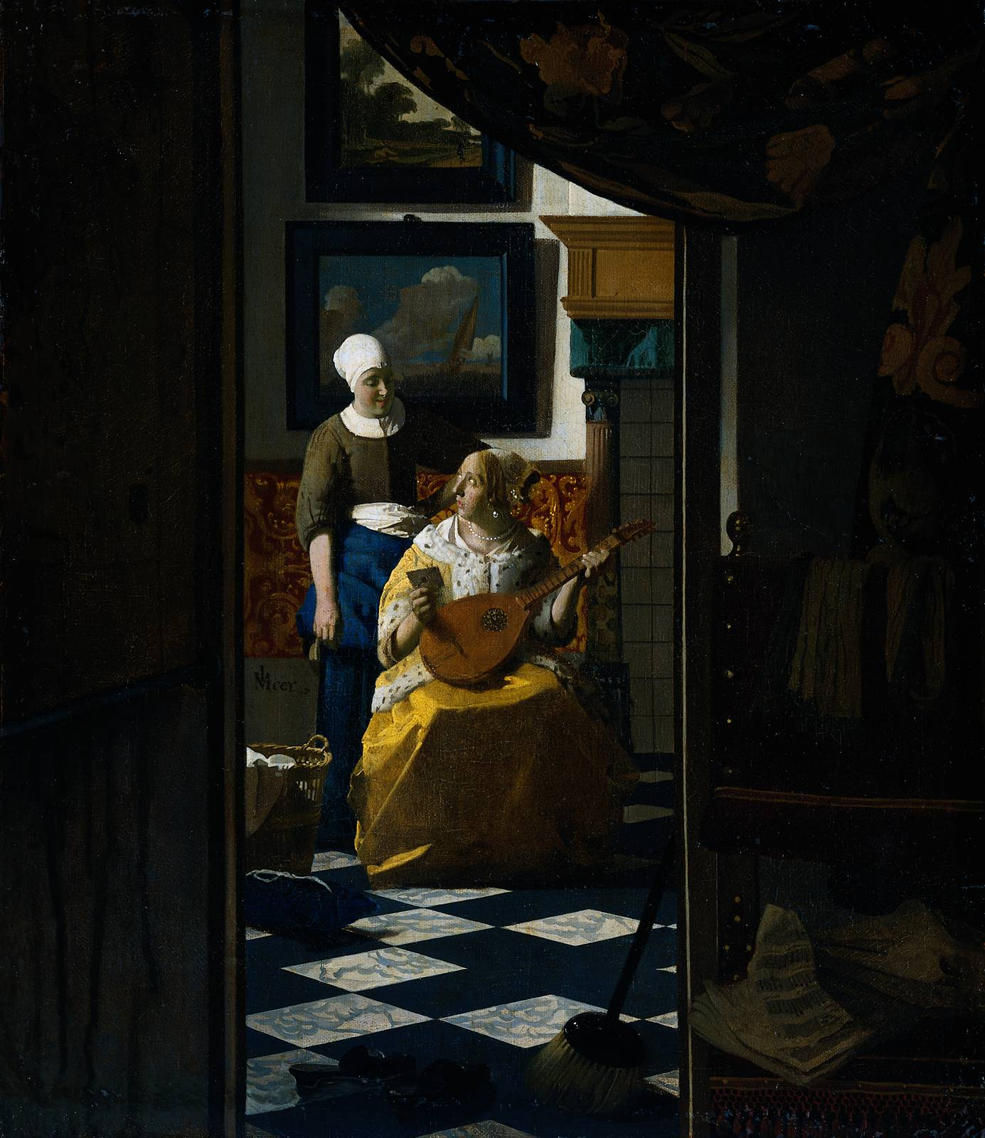
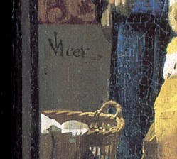
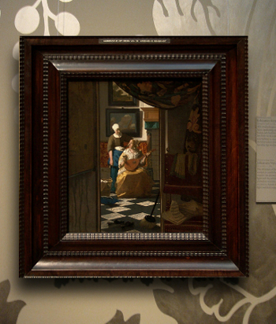
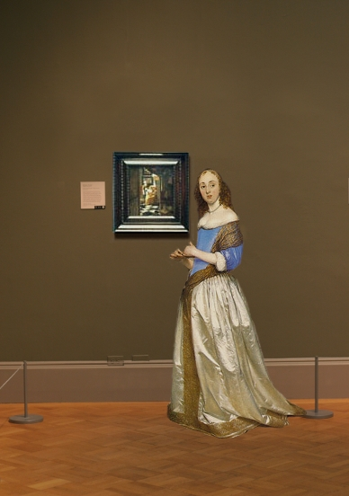
THE LOVE LETTER (De liefdesbrief) c. 1667-1670 oil on canvas 17 3/8 x 15 1/8 in. (44 x 38.5.cm) Rijksmuseum, Amsterdam

Slide 3
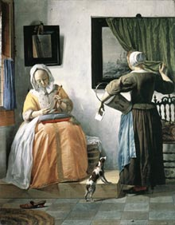
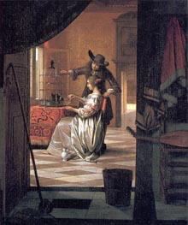

Slide 4
It is largely accepted that Vermeer used a camera obscura (a kind of precursor to the modern photographic camera) as an aid to his painting. The camera obscura was well known in both scientific and artistic circles and was recommended to painters for both studying nature as well as tracing its image to shortcut problems of drawing and perspective. Although the camera obscura leaves no physical trace on the canvas, many of the peculiar characteristics of the image it produces may be found in the Love Letterand in many other paintings by Vermeer, especially the so-called pointillés. Pointillés, or spherical disks of light are produced by the imperfect lens of the 17th-century camera obscura in situations of extreme light contrast. Pointillés can clearly be observed on the clothes hamper and on the gilded leather wall covering (see detail left) behind the maid and mistress.

Slide 5
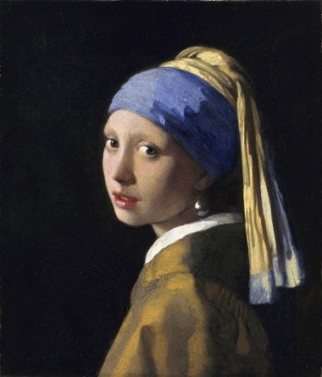
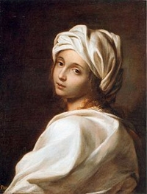
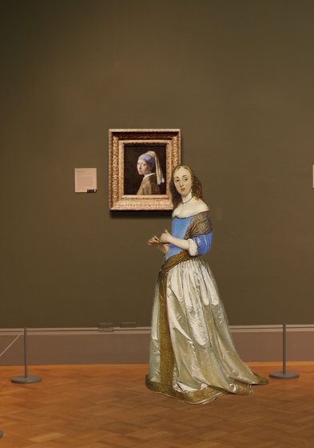
GIRL WITH A PEARL EARRING (Meisje met de parel) c. 1665-1667 oil on canvas 18 1/4 x 15 3/4 in. (46.5 x 40 cm.) Koninklijk Kabinet van Schilderijen Mauritshuis, The Hague

Slide 6
